Slide 1
APPLYING DATA MINING TECHNIQUES TO MONITORING DATA FROM A DATA CENTRE TO IMPROVE ITS ENERGY EFFICIENCY
Project Proposal
Student: John Fitzpatrick
Supervisor: Dr. Bernard Butler

Slide 2
Overview
Introduction and Background
Research Aims and Objectives
Research Questions
Literary Review
Working Theory and Research Method
Project Plan

Slide 3
Introduction and Background
What is a Data Centre?
A Data Centre is a dedicated facility with all the resources required for storage, processing and sharing digital information and its supported areas.
Why are they so prominent now?
Because In the modern economy, the demand for cloud storage and cloud computing based applications has grown exponentially as the number of internet users who rely on digital information via cloud services continues to sky-rocket across the world
So why does that matter?
Data Centres are the fastest growing sector in terms of energy consumption within ICT and are now responsible for over 2% of the global CO2 emissions.
So… There is a cost and green incentive to make them more energy efficient.

Slide 4
Research Aims and Objectives
Overall Aim: To make a Data Centre more Energy Efficient…
But how can this be done?
Implement Best Management Practices
Make Improvements at physical/hardware level (New Technologies)
Use Monitoring Data from a Data Centre and Data Mining Techniques to unlock hidden insights about energy demand and the use of energy supply.
Specific Objectives
Review Existing Literature (On Data Centre Energy Efficiency)
Identify suitable Data Mining Techniques
Obtain Monitoring Data from TSSG Data Centre
Use the Data Mining Techniques and the Monitoring Data from TSSG Data Centre to better understand and predict when there is a peak in demand so that the supply of energy can be better utilized
If energy demand can be predicted, supply can be managed more effectively to reduce consumption – making the Data Centre more energy efficient

Slide 5
Research Questions
From Monitoring Data provided by the WIT-TSSG Data Centre and using a Data Mining based approach,
Can we identify predictive indicators from the data that forecast an unanticipated peak in energy demand at the Data Centre?
Can we identify features in the data that indicate where the Data Centre is not optimally consuming its supply of energy?

Slide 6
Preliminary Literary Review
3 Key Concepts
What is a Data Centre, Trends in Data Centre Energy Consumption and an introduction to the WIT-TSSG Data Centre.
Improving Data Centre Energy Efficiency.
Data Mining Techniques for improving Energy Efficiency in Buildings.

Slide 7
Preliminary Literary Review
Concept 1:
What is a Data Centre, Trends in Data Centre Energy Consumption and an introduction to the WIT-TSSG Data Centre.
Authors | Year | Contribution(s) to Literature Review
Levy and Raviv | 2018 | Data Centre Definition Data Centre Infrastructure How energy is consumed in a Data Centre
Vasudevan et al | 2017 | Reasons behind growth in Data Centres
Avgerinou et al | 2017 | Statistical information on the Energy Consumption of Data Centres across EU/US Historical Trends of Energy Efficiency of Data Centres Other Factors that Contribute to Energy Consumption in a Data Centre
TSSG Website | 2018 | Detailed Description of WIT-TSSG Data Centre

Slide 8
Preliminary Literary Review
Concept 2:
Improving Data Centre Energy Efficiency.
Authors | Year | Contribution(s) to Literature Review
Masanet et al, Mahdavi & Tschudi, Liu and Terzis | 2008, 2013, 2013 | The importance of implementing a wireless sensor system to capture key monitoring data in a Data Centre
Arjona et al | 2014 | Uses sensor data to analyse server usage
Bi et al | 2015 | Propose a multi-tier architecture-orientated virtualized application performance model to allocate computing resources to each machine based on SLA
Rygielski et al | 2016 | Develops simulation models to predict the performance of networks
Marcos-Jorquera et al | 2016 | Develop a monitoring service for Management
Levy and Raviv | 2018 | Advance a Data Centre multidimensional Scorecard
Vasudevan et al | 2017 | Analyse log data to profile applications using the Data Centre

Slide 9
Preliminary Literary Review
Concept 3:
Data Mining Techniques for improving Energy Efficiency in Buildings.
Authors | Year | Data Mining Techniques | Building Type
Xue et al. | 2017 | Clustering techniques to identify seasonal and daily operating patterns and Association rules mining to identify faults and malfunctions | District Heating Substation
Kuo et al | 2018 | Regression and Classification Techniques | Convenience Stores
Fan et al. | 2018 | Decision trees, motif discovery and gradual pattern mining | Education Building in a University
Zhou et al. | 2018 | Information gain Ratio Algorithm and Decision Tree Classifiers to look at the correlation between energy consumption and building physics | Homes
Ahmad and Chen | 2018 | Gaussian Process Regression to predict the future heating and cooling demands in building environments | Homes
Wang et al | 2017 | Random Forrest Algorithm | building air-conditioning systems

Slide 10
Working Theory and Research Methods
What is the Gap Identified from the Literature Review:
Improve Energy Efficiency of Data Centre by using Data Mining Techniques on the monitoring Data of a Data Centre
Build a Predictive Model
To analyse the Data Centres own monitoring data anticipate a surge in energy demand
Which will allow the Data Centre to utilise its supply of energy
Switch loads between servers
Reduce the demand for coolers
Identify inefficient practices
Identify systems faults (faulty equipment)
Which will make the Data Centre more efficient for the supply it is consuming

Slide 11
Research Data and Method
Data Available from TSSG (This is already available)

Slide 12
Research Data
Preliminary Data Analysis (Highlights)

Slide 13
Research Data
Preliminary Data Analysis (Highlights)

Slide 14
Research Method
Data is already available (Static data going back to 2014)
Time series Data (gathered at 5 minute intervals)
Import Data to Python for Detailed Data Mining Investigations
Utilise Data Mining Techniques outlined in Preliminary Literary Review
Regression could be used to predict Energy Consumption by looking at different servers combined with weather information or the supply of water to the cooler systems
Clustering could be used to look at the relationships between these predictors and derive some intuition regarding correlations between different events and problems with the chillers
Exact method not known until next stage of the project gets under way!
Trial and Error
Testing on different subsets of data
Goodness of fit measures will also be examined
Future Use – Use model on live streaming data

Slide 15
Project Plan

Slide 16
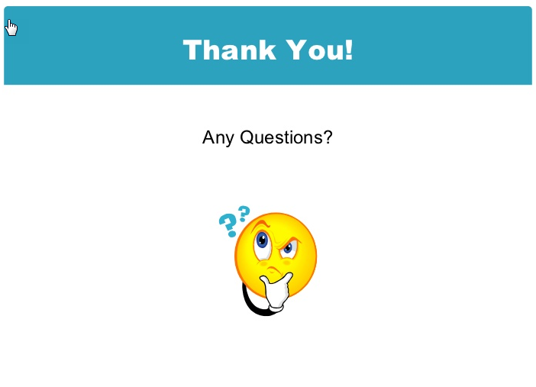
Thank you and Questions

